Slide 1


Dept. of CS&E ( DATA SCIENCE) Adichunchanagiri Institute of Technology Chikkamagaluru - 577102
Mini Project –title on
“Travel Journal with Map Integration“
Presented By,
Chandana M (4AI22CD012)
Darshith C (4AI22CD015)
Madhura N M (4AI22CD032)
Rao Siddharth Shankar (4AI22CD042)
Under the Guidance of
Prof. Pallavi C S

Slide 2
Problem Statement
To develop a travel journal application that allows users to document their trips and experiences while tagging entries with geographical locations on an interactive map. This provides users with a visual and contextual representation of their travels, enhancing the storytelling experience.

Slide 3
Scope Of The Project
Key areas that the project focuses on
Location Mapping: Integrating maps (e.g., Google Maps) to plot travel destinations with markers.
Journal Entries: Allowing users to write and attach entries and photos for the specific journey.
Storage: Storing user data (journal entries, images, locations) securely using databases (e.g., MySQL).
Customizable Features: Enabling and disabling of the waypoints.

Slide 4
Personal Benefits
Memory Preservation: Allows users to document their travels with text, photos, and maps, creating a digital scrapbook to relive moments.
Enhanced Storytelling: Makes sharing travel experiences more immersive and engaging by combining journal entries with interactive maps.
Organization: Helps travelers organize and categorize their experiences geographically and chronologically.
Self-Reflection: Encourages users to reflect on their journeys, fostering a deeper connection to their experiences.
Travel Planning Resource: Provides useful information and inspiration for others planning trips to similar destinations.
Sustainable Awareness: Promotes responsible travel to the users.

Slide 5
Project Design Architecture
Frontend:
Technologies: HTML, CSS, JavaScript.
Features : Map integration using APIs like Google Maps API(Directions API , Places API, Distance matrix API, Geocoding API , Maps JavaSript API). Journal entry forms with rich-text editors and media upload options.
Backend:
Technologies: Python (Django).
Features : User authentication and session management . Media file handling using local database.
Database:
Options : Relational (MySQL) for structured user data.
Hardware :
Inbuilt GPS on user devices for geolocation data.

Slide 6
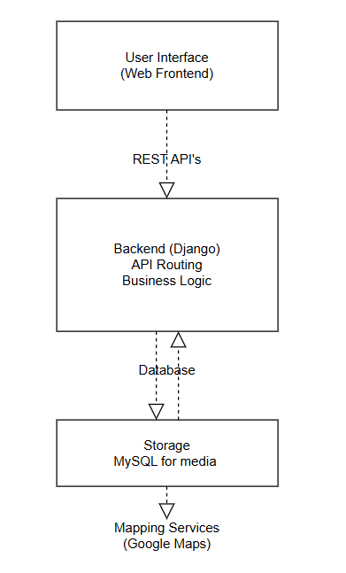
Block Diagram

Slide 7
Methodology
Steps or Approach Followed
Requirement Analysis : Identify user needs and features such as geolocation tagging, multimedia uploads and interactive maps .
Design Phase : Create a system architecture (frontend, backend, database, and APIs). Design UI/UX mockups for the journal entry forms, interactive map, and user dashboards.
Development Phase : Integrate map features using APIs like Google Maps
Backend Development : Set up server-side logic with Python (Django).Develop REST APIs for CRUD operations (e.g., add, edit, delete entries).
Testing Phase : Conducted unit testing for individual features (e.g., map integration, GPS capture).

Slide 8
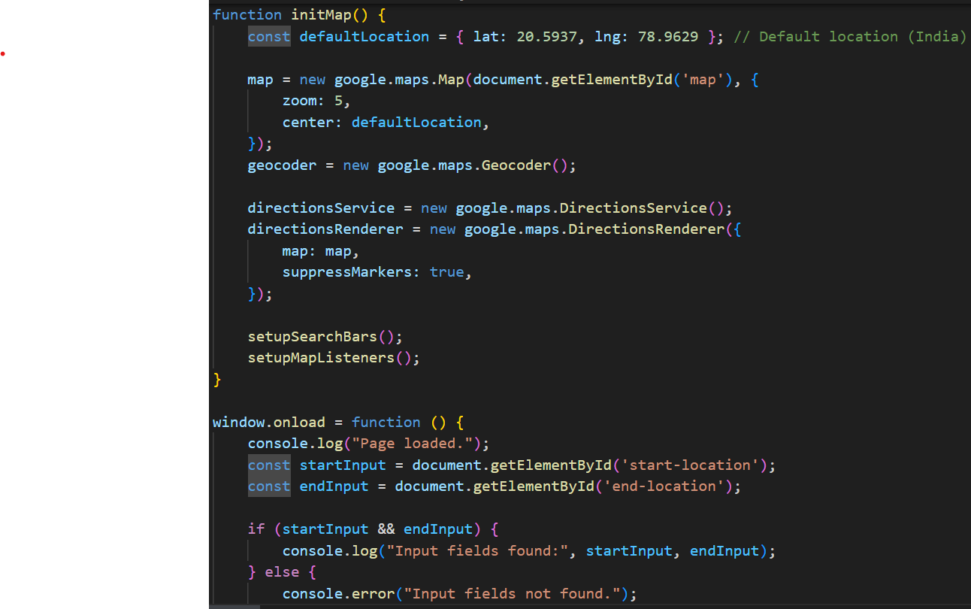
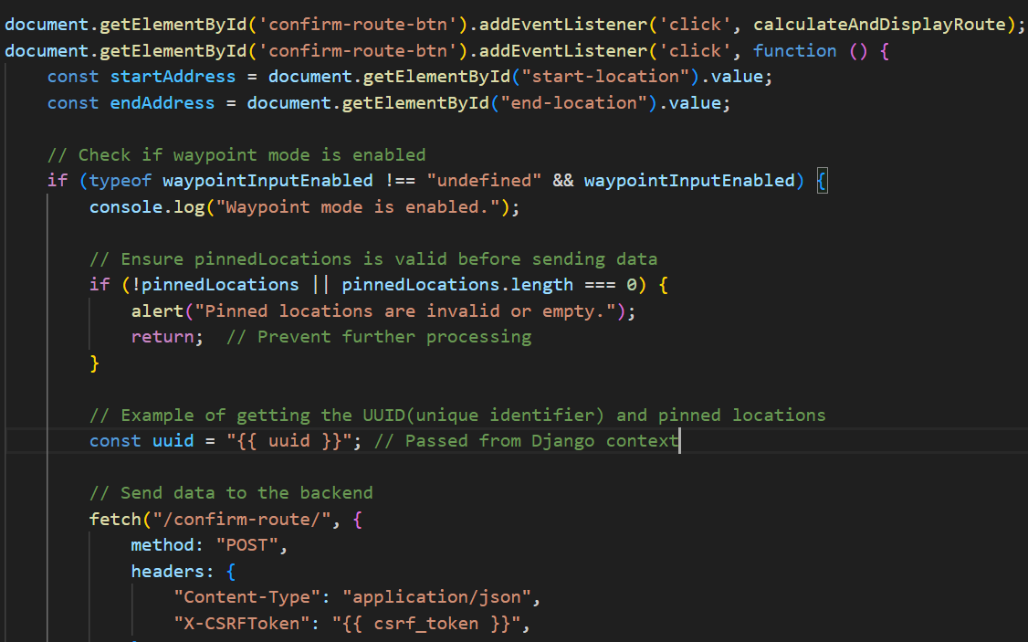
Highlights Of The Code

Slide 9
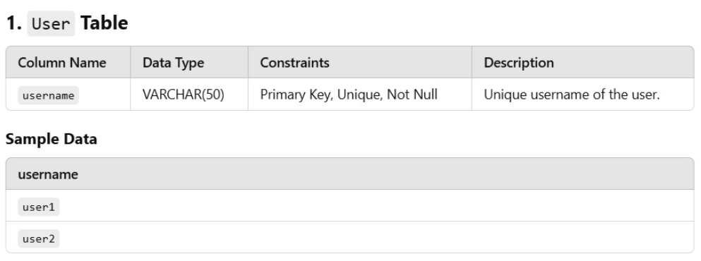
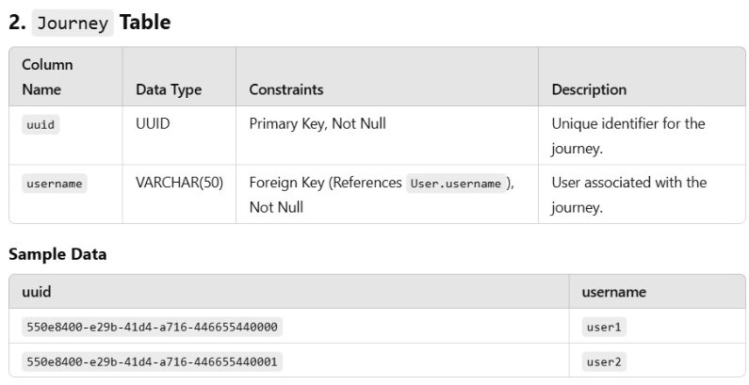
Database Design

Slide 10
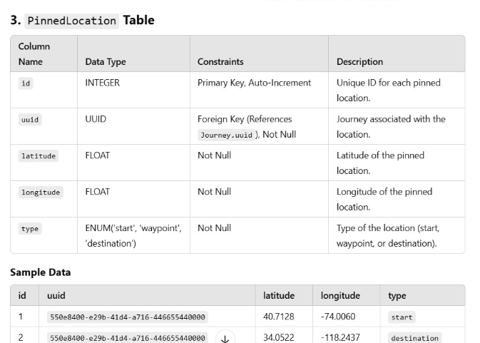
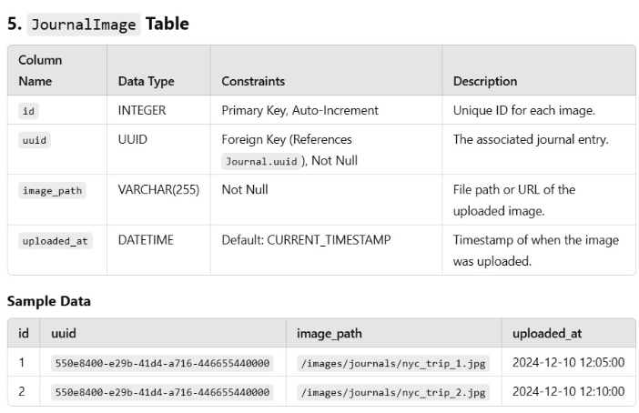
Database Design

Slide 11
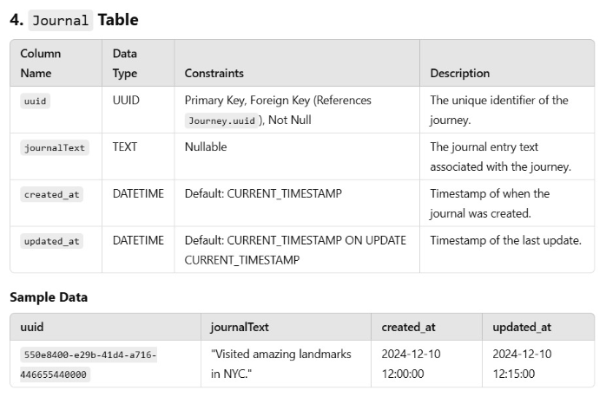
Database Design

Slide 12
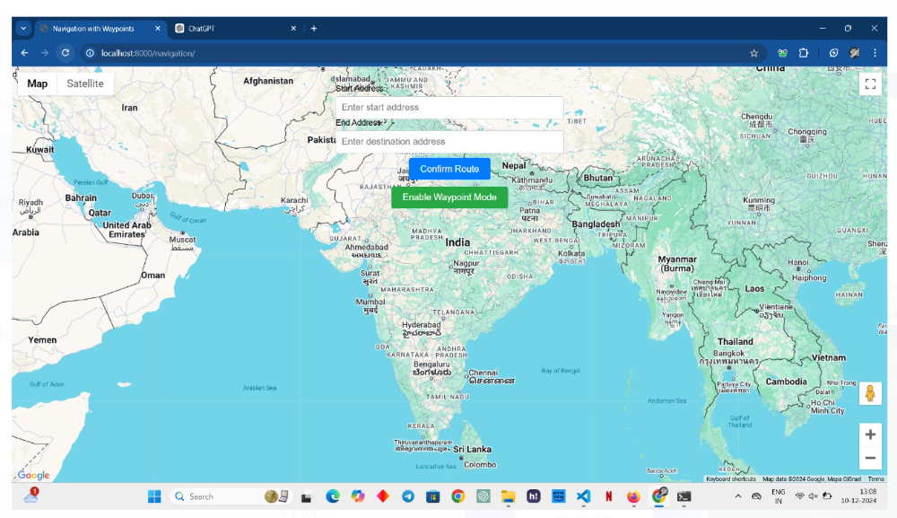
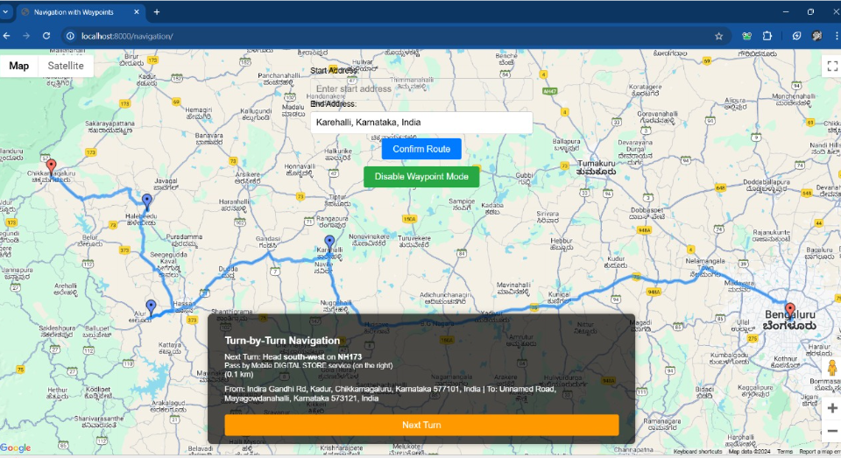
Snippets of Output

Slide 13
Challenges Faced
Images were not being stored or displayed on the main screen.
Database integration issues while fetching data and executing queries.
Failure to load the map interface.
Overlapping of pins while marking locations on the map.
Challenges in identifying and designing the required database schema.
Creation of a new database schema due to previous design problems.
Issues in accessing the Google API for map and location services.

Slide 14
Resolved
Image Storage and Display Issue:As images were being stored in a sub-directory path, we reconfigured the system to save them in the main directory.
Database Integration Issue:We successfully connected the database and adjusted the queries, enabling the application to fetch and store data seamlessly.
Map Loading Issue:The issue was resolved by debugging the map integration code and ensuring the correct API keys and configurations were in place.
Location Pin Overlapping Issue:We adjusted the logic for pinning locations to prevent overlaps, ensuring that each pin is displayed clearly on the map.
Google API Access Issue:We resolved this by troubleshooting API access errors, ensuring correct permissions, and configuring the API settings properly.

Slide 15
Future work
Social Sharing: Allow users to share their travel experiences and pinned locations on social media platforms.
Collaborative Journaling: Add functionality where friends or family can contribute to the same journal.
Offline Access: Enable users to access their journal and maps offline when traveling in areas with no internet.
AI Travel Suggestions: Suggest nearby attractions, restaurants, and activities based on the user's location.
Integration with AR: Use Augmented Reality to enhance the map experience, showing real-time information about landmarks.
Customizable Features: Options to add tags, categories, or themes to personalize the journal.

Slide 16
Conclusion
Our Travel Journal with Map Integration project has been an enriching and exciting journey. Despite challenges like image storage, database integration, map loading issues, and schema design, we overcame them through teamwork and determination. By optimizing image storage, redesigning the database schema, and successfully integrating the map and Google APIs, we ensured a smooth and user-friendly application . This project not only enhanced our technical skills but also brought us closer as teammates. We take pride in our accomplishments and look forward to exploring future enhancements for the application.

Slide 17
GITHUB LINK
chandanam2004/Chandana-M
https://github.com/sidd1224?tab=repositories
https://github.com/madhuranm29/Madhuranm
https://github.com/DarshithChandra/travel-journal-with-map-intigration.git

Slide 18
Thank You

